Slide 1
Back-propagation

Slide 2
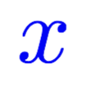
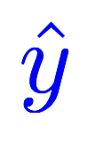

Computing gradient in simple network
Linear
Gradient of loss with respect to w
# compute gradient
def gradient(x, y): # d_loss/d_w
return 2 * x * (x * w - y)
Notes:
loss = (\hat{y}-y)^2 = (x*w-y)^2
\frac{\partial{loss}}{\partial{w}}=?

Slide 3
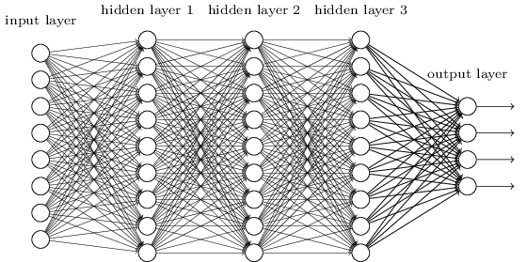
Complicated network?
Gradient of loss with respect to w
Notes:
loss = (\hat{y}-y)^2 = (x*w-y)^2
\frac{\partial{loss}}{\partial{w}}=?

Slide 4
What is Backprop
一個神經網路中，會有多個權重和偏置(w及b)
為了計算每個w及b的變化，造成loss function的變化，我們需要針對每一個變數找出梯度，就是針對每一個變數對loss function的偏微分
每個變數的梯度算出後，就使用sgd進行最佳化
利用連鎖律從loss function向前推導偏微分，就稱之為backprop
Notes:
loss = (\hat{y}-y)^2 = (x*w-y)^2
\frac{\partial{loss}}{\partial{w}}=?

Slide 5
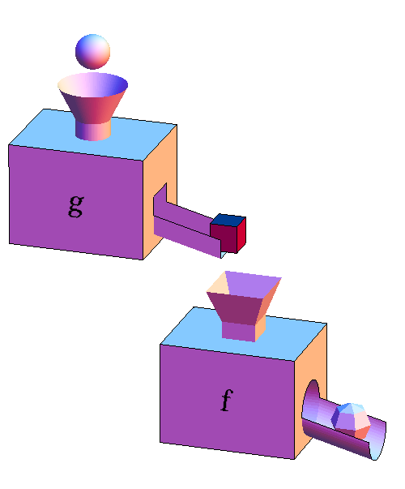
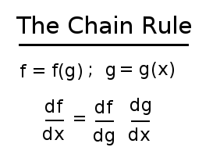
Chain Rule
http://mathinsight.org/image/function_machines_composed

Slide 6
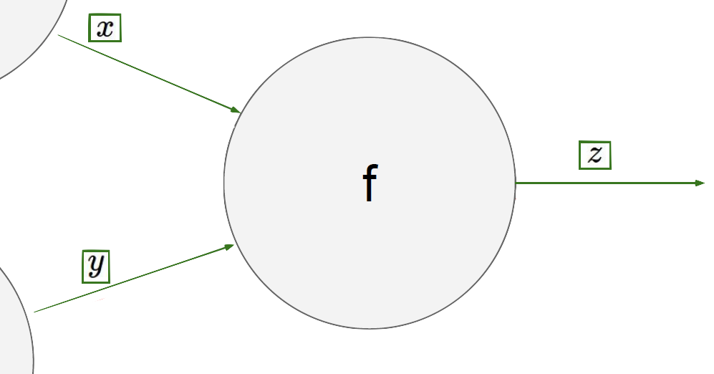
Chain rule
… LOSS

Slide 7
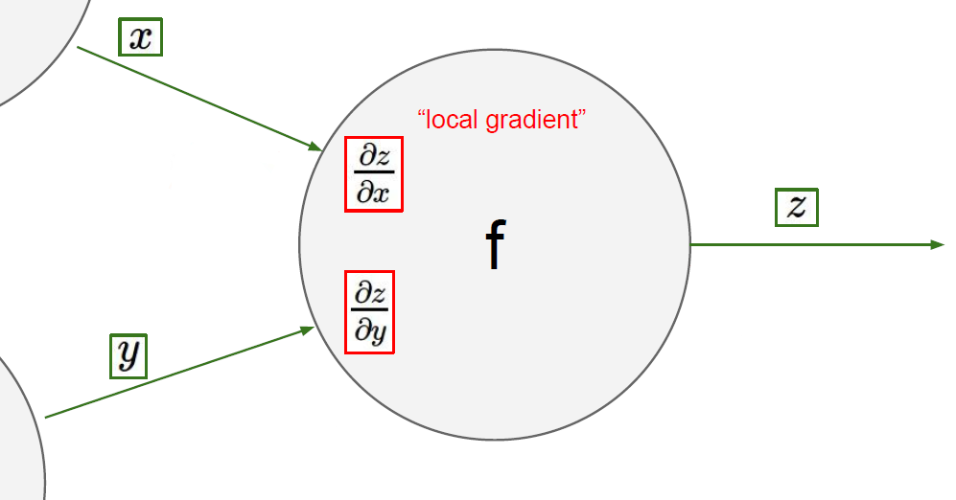
Chain rule

Slide 8
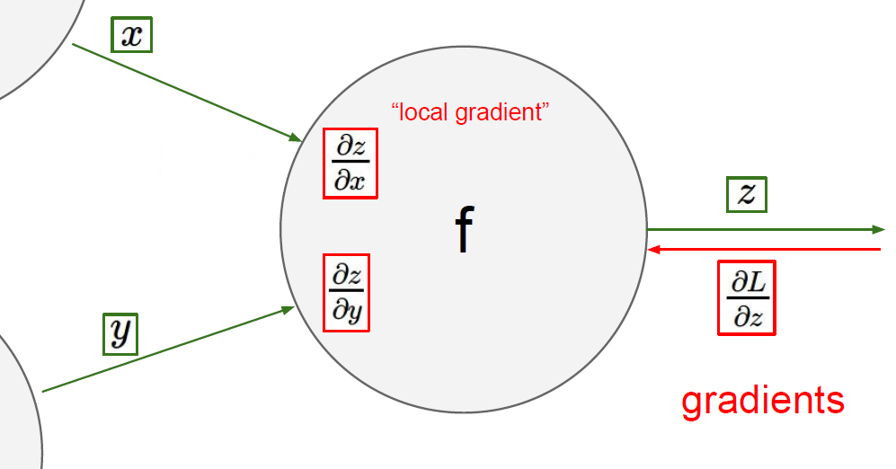

Chain rule

Slide 9
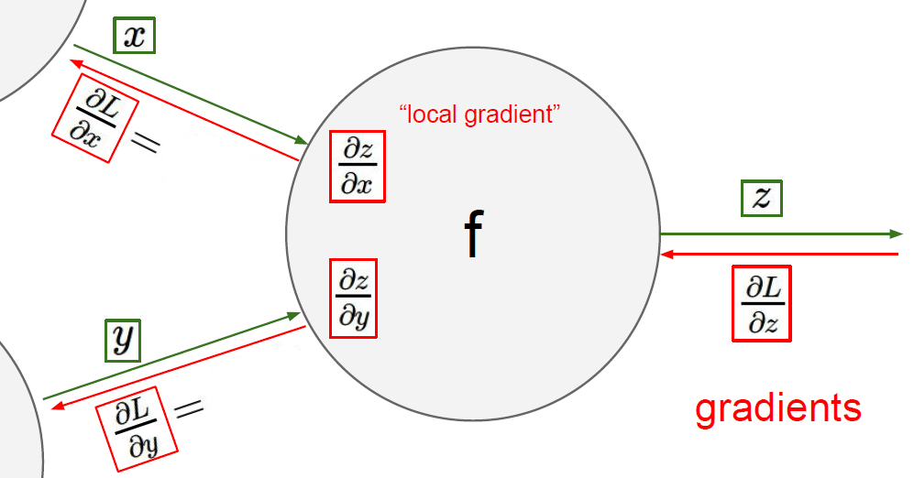
Chain rule

Slide 10

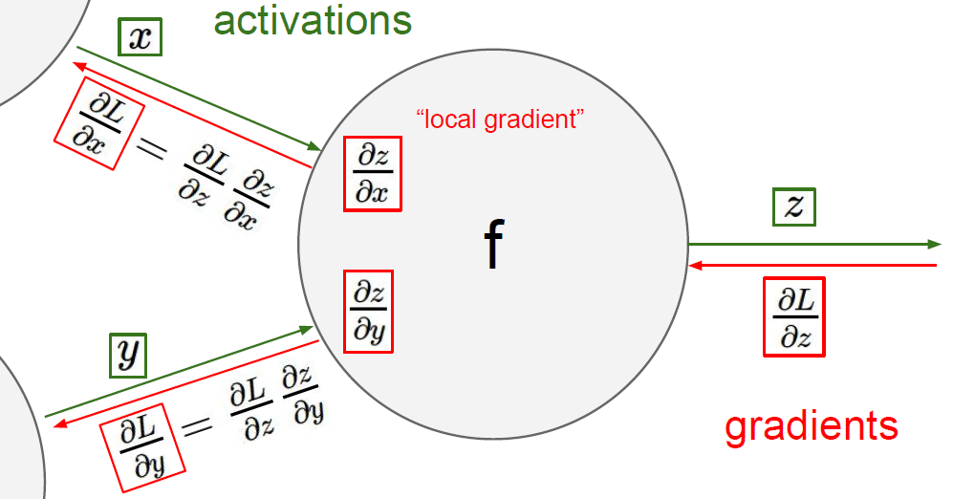
Chain rule

Slide 11
*

Slide 12

Forward pass x= 2, y = 3
*

Slide 13
= 2
*
= 6
= 3

Slide 14

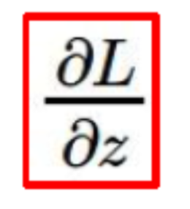
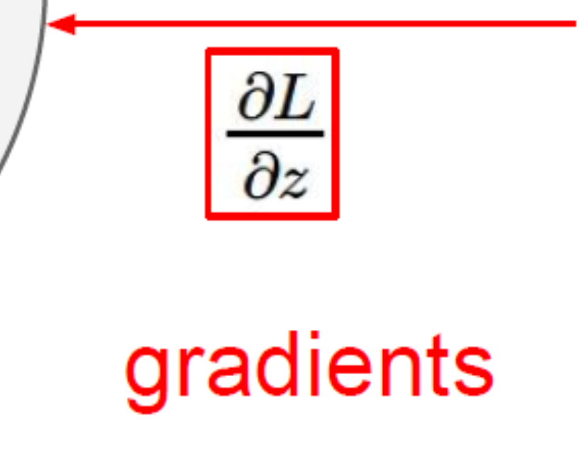
Backward propagation
= 5 is given.
= 2
*
= 6
= 5
= 3

Slide 15
Backward propagation
= 5 is given.
= 2
= y
*
= 6
= x
= 5
= 3

Slide 16
Backward propagation
= 5 is given.
= 2
= y
*
= 6
= 5*y = 15
= x
= 5
= 3
= 5*x = 10

Slide 17

Computational graph
Notes:
loss = (\hat{y}-y)^2 = (x*w-y)^2
\frac{\partial{loss}}{\partial{w}}=?

Slide 18
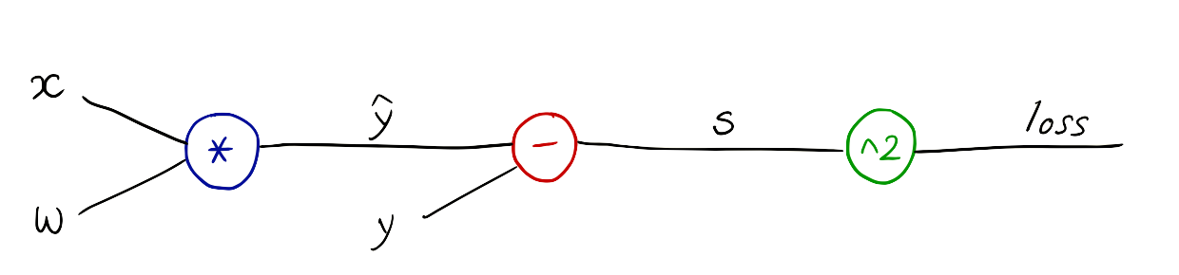
Computational graph
Notes:
loss = (\hat{y}-y)^2 = (x*w-y)^2
\frac{\partial{loss}}{\partial{w}}=?

Slide 19
Computational graph
Notes:
loss = (\hat{y}-y)^2 = (x*w-y)^2
\frac{\partial{loss}}{\partial{w}}=?

Slide 20
Computational graph
Notes:
loss = (\hat{y}-y)^2 = (x*w-y)^2
\frac{\partial{loss}}{\partial{w}}=?
\frac{\partial{z-y}}{\partial{}z}=1

Slide 21
Forward pass x=1, y = 2 where w=1
Notes:
loss = (\hat{y}-y)^2 = (x*w-y)^2
\frac{\partial{loss}}{\partial{w}}=?

Slide 22




Backward propagation
=1
=1
=-1
=1
=1
=2
Notes:
\frac{\partial{\hat{y}-y}}{\partial{\hat{y}}}=1

Slide 23



Backward propagation
=1
=1
=-1
=1
=1
=2
Notes:
\frac{\partial{\hat{y}-y}}{\partial{\hat{y}}}=1
\frac{\partial{loss}}{\partial{s}}=2s=-2
—-
\frac{\partial{loss}}{\partial{\hat{y}}}
=
\frac{\partial{loss}}{\partial{s}}
\frac{\partial{s}}{\partial{\hat{y}}}
=-2*1=-2
—-

Slide 24


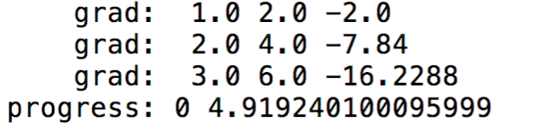
Backward propagation
=1
=1
=-1
=1
=1
=2
Notes:
\frac{\partial{\hat{y}-y}}{\partial{\hat{y}}}=1
\frac{\partial{loss}}{\partial{s}}=2s=-2
—-
\frac{\partial{loss}}{\partial{\hat{y}}}
=
\frac{\partial{loss}}{\partial{s}}
\frac{\partial{s}}{\partial{\hat{y}}}
=-2*1=-2
—-

